Slide 1
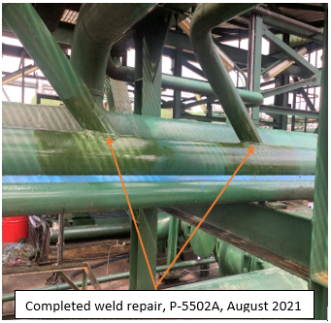
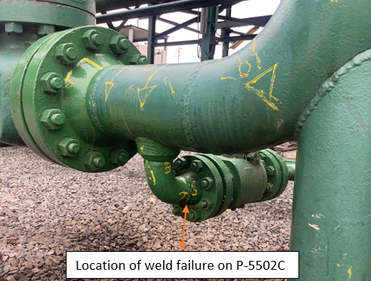
Soku Spiking System Availability – MTO ID: Id I-1609665
Challenge
Frequent failures/pin-hole leaks on Condensate Spiking Pumps discharge headers.
P-5502A in July 2021, P-5502C in November 2021, P-5502A in October 2022 and P-5502C in December 2022
Deferment impact from N+1 unavailability on PMC demand @ 7kbbls/day and associated gas.
Investigations conducted:
Structural integrity assessment of foundations and piping supports (February 2021, February 2022)
NDT inspections on welds in condensate spiking pump piping (August 2022, December 2022)
Vibration assessment of pipework in condensate spiking pumps area (November 2022)
Identified issues:
Period of production volumes ≥ system capacity, high vibration, failed/depleted dampeners, production weld defects, consolidated settlement causing gaps between pipe and supports, legacy construction issues around piping supports
Solution (fallout of investigations and RCA by representatives from Asset, OABP, Inspections and Civil disciplines etc.
Agreed short-term actions as follows:
Replace defective dampeners on the pump discharge outlet.
Repair weld failure on P-5502C & identified weld defect on P-5502B, both on 2” closed drain tie-in to discharge header.
Introduce temporal support around the site of repeat weld failures.
Long term plan
Carry out full weld repair of all identified weld defects
Install additional piping supports around condensate spiking pumps area
Expected Result
ZERO weld failure, increased availability of spiking pumps
Look Ahead
Delivery of new dampener (on PR 10770121) and installation on P-5502B.
Civil modification works to introduce additional piping supports (during October 2023 TAM).
Weld repairs of all identified weld defects (during October 2023 TAM).
Team members
Akinjagunla Oluwashina, Okiomah Andrew, Ikede Kenneth, Orajaka Chinenye, Okoro Fredricks, Anyachor Nnaemeka.

Slide 2

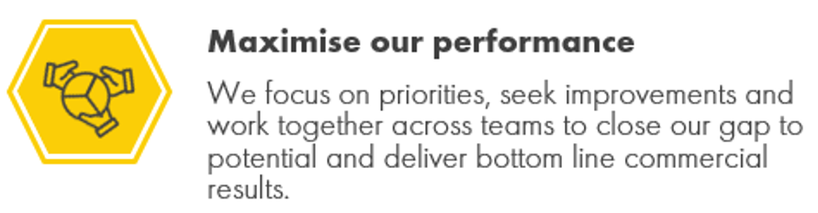
DIY: Resolution of legacy problem on Atlas Copco XATS 487 Mobile Air-compressor. MTO ID: Id I-1711270
Problem: Compressor unable to start automatically upon depletion of instrument air header pressure to preset value of 7.5bar
Manual start-up by operator, not healthy for the compressor.
Actions
- OGANNO Emmanuel
Reviewed equipment manual
Engaged with OEM representative
Result
Compressor commissioned successfully, auto start problem resolved.
Threat of Plant trip and associated deferment
Previous troubleshooting efforts didn’t identify fault.
Plan to mobilize OEM vendor to site at ca. F$1,000 / day
Both regular Airpack compressors with mechanical and electrical related faults.
Online research conducted to understand problem
Identified a check valve / oil stop valve as cause of issue.
Mobilized a team, retrieved, serviced and re-instated the check valve / oil stop valve.
Developed competence on troubleshooting of compressor and cascaded to other team members.
Averted cost on mobilization of OEM vendor to site.
Eliminated threat of plant trip on low instrument air
Other Team Members:
Thomas Dokubo, Maintenance support crew

Slide 3
Soku GP K2S Slug catcher 11LCV901 Repairs/Overhaul. MTO ID: Id I-1711271
Challenge
11LCV901 have been having frequent failure leading to inability of producing K2S wells at Soku GP. There is a long-term plan to changeout the valve from current globe valve to Mokveld Axial control valve. During the Pigging operations on the K2S bulk line, the foam pig got shattered leading to clogging of 11LCV901 and as the result there was high level in the slug catcher.
Identified issues as follows: Clogged Casing, Defective Valve plugs, seat rings, stems and clamps.
Solution
Removal of defective valve and cleaning of foams and debris from the valve’s casing. Installation of previously overhauled valve.
Proactively Sent out defective LCV to IA Instrument workshop for overhaul.
Collaborated with IA workshop to carryout overhaul on the defective valve at zero cost by providing the critical spares (Seat Rings, Plug, Casing, Stem).
These spares were sourced from other PU and previously procured list in the past.
Achieved Cost avoidance of circa. $40k
Moved overhauled valve to Soku and staged properly. Proactiveness to avert delays in event of any future failure.
Result
Continuous operation of K2S wells. Ease of control and inventory management on K2S slug catcher.
Available spare on-site for replacement in event of failure. Less downtime
Look Ahead
Sustain operations of 11LCV901 by proactive monitoring.
Install the overhauled valve in event of failure on the exiting valve.
Progress procurement of 6X900RF Axial control valve F$ 150k - OABP
Execute Piping Modification for installation of 6x900RF valve during October 2023 TAM.
Team members
Nsikak Ekpoh, Adesina Lukmon, Oguzie Austin, Elisha Bassey, Uranta Noble, Aniebiet Roberts

Slide 4
EGGS1 Pipeline Depressurization(Soku to Bonny) with Gas Leak. MTO ID: Id I-1711276
Challenge
The EGGS1 line is a 40” X 95km pipeline from SOKU to NLNG used for gas and condensate export. The line was scheduled for depressurization to enable repair of an identified leak point. Based on available historic data in 2015 and 2016, the depressurization scope was frozen for 9 days.
Solution
The SOKU operation team, leveraged on past knowledge and experience to develop a simple but strategic process to depressurize the EGGS1 line in a record time by identifying and using multiple manual and actuated depressurization points with little or no support from NLNG. The activity involves large scope of manually isolating over 27 valves to separate EGGS1 from EGGS2, lining EGGS1 to flare while simultaneously exporting gas from GBARAN to NLNG through the loop line.
Result
Goal zero was achieved
Gas security of supply assured
Depressurization was achieved in 4 days against a 9 day target
Team members
Anuku Ifeanyi, Victor Orukpke, Igbokwe Michael, Nkogbu Emmanuel, Shodipo Ibrahim, Udo Ekemini, Hilary Aruegbe, Esume Vivian, Piate Chris, Akpabio Godwin, Ukenye Sunday, Chinedu Nwachukwu, Enyi Progress, Eweama Kingsley, Uzomma Ebonine, Atu john, Igbokwe Michael

Slide 5
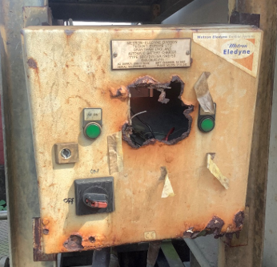

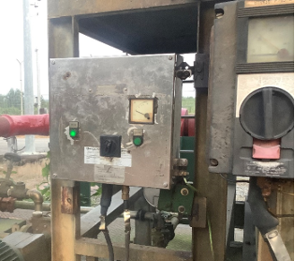

DIY: Refurbishment of corroded foam pump control panel. MTO ID: Id I-1711273
Situation
Foam pump is used to inject foam into condensate storage tank for fire fighting purposes.
Battery starter system unavailable with the battery charger control panel in derelict condition.
Action
Determined to fix the battery charger control panel
Sourced materials
Outcome
Restored the control panel, ensured availability of foam pump on demand.
A new look foam pump control panel.
Limited operation of charger, frequent battery downtime, inability to start foam pump engine promptly.
Carried out refurbishment activities
Commissioned unit.
Pump is part of fixed foam systems in Soku Gas Plant, an SCE to provide application of foam to prevent, or mitigate, hydrocarbon pool fuel fires
- Disconnected battery terminal cables, removed defective panel
- Drilled new panel to create slots for connections
- Internal re-wiring of control panel
- Installation and reconnection of cables including battery terminals
Delivered a healthy battery charger system.
Ensured system functionality to meet SCE PS011 minimum assurance task
Corroded foam pump panel
Other Team Members:
AYOR Christian, ENWEFAH Lucky, SUNDAY Chukwudi, BESTMAN Nabo, OKEE Godspower, OFOEGBU Golden, ANIEFIOK Ephraim
Foam pump panel after refurbishment works

